Slide 1
Data Engineering Capstone Project-1
Introduction:
In this project the major task is to analyse the data of the employee of one of the big corporation from 1980’s and 1995. We are given with six CSV files from that period. This project mainy emphasis on designing the tables to hold data in the CSVs, import the CSVs into MYSQL database, import to HDFS/Hive using sqoop commands and creating in hive/impala importing data from MYSQL database and performing EDA(Exploratory Data Analysis) and perform analysis using PYSpark and to build a spark ML model and create end to end pipeline.

Slide 2
DATA USED AND DESCRIPTION:
Titles (titles.csv):
title_id – Unique id of type of employee (designation id) – Character – Not Null
Title – Designation – Character – Not Null
Employees (employees.csv):
emp_no – Employee Id – Integer – Not Null
emp_titles_id – designation id – Not Null
birth_date – Date of Birth – Date Time – Not Null
first_name – First Name – Character – Not Null
last_name – Last Name – Character – Not Null
sex – Gender – Character – Not Null
hire_date – Employee Hire date –Date Time -Not Null
no_of_projects – Number of projects worked on – Integer – Not Null
Last_performance_rating – Last year performance rating – Character – Not Null
left – Employee left the organization – Boolean – Not Null
Last_date - Last date of employment (Exit Date) – Date Time Data Description Data

Slide 3
Salaries (salaries.csv):
emp_no – Employee id – Integer – Not Null
Salary – Employee’s Salary – Integer – Not Null
Departments (departments.csv):
dept_no - Unique id for each department – character – Not Null
dept_name – Department Name – Character – Not Null
Department Managers (dept_manager.csv):
dept_no - Unique id for each department – character – Not Null
emp_no – Employee number (head of the department ) – Integer – Not Null
Department Employees (dept_emp.csv)
emp_no – Employee id – Integer – Not Null
dept_no - Unique id for each department – character – Not Null

Slide 4
TECHNOLOGY STACK USED:
MySQL: to create database.
Linux Commands: to perform ETL ( Extract, Transfer, Load ).
Sqoop : Transfer data from MySQL Server to HDFS/Hive) .
HDFS : to store the data.
Hive : to store and retrieve data.
Impala :to perform the EDA(Exploratory Data Analysis).
SparkSQL: to perform the EDA (Exploratory Data Analysis).
SparkML: to perform model building and creating pipeline.

Slide 5
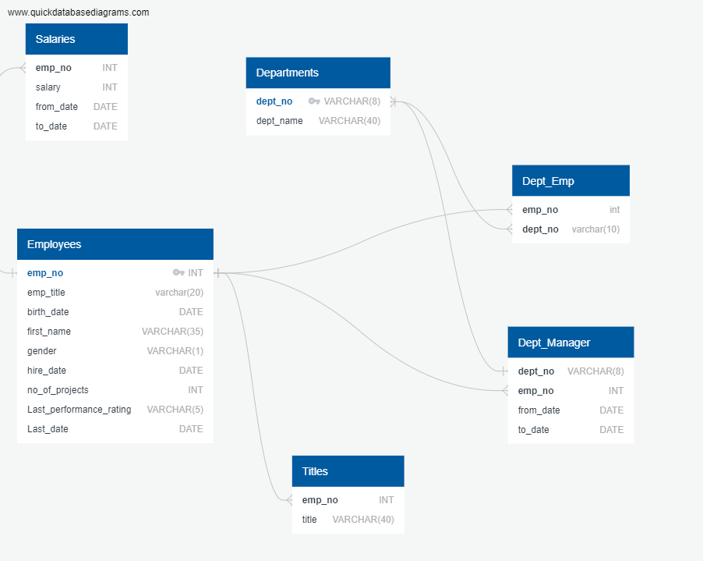
ER-DIAGRAM :

Slide 6
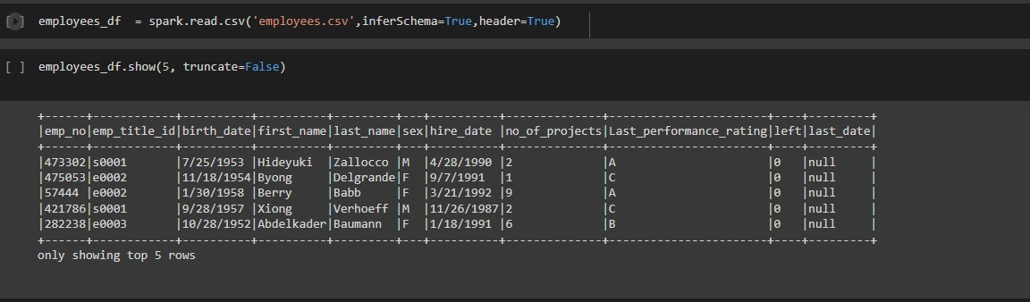
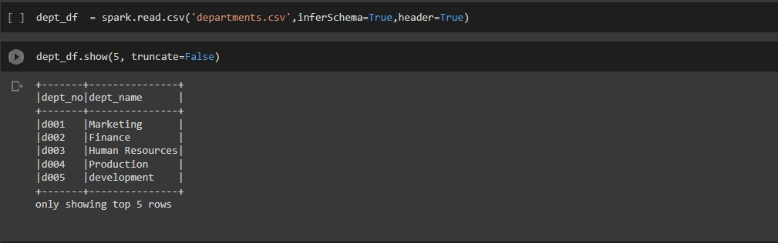
OUTPUTS:
Code to read employee data
Code to read department data

Slide 7
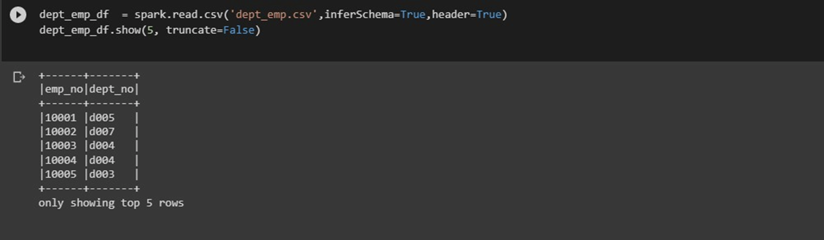
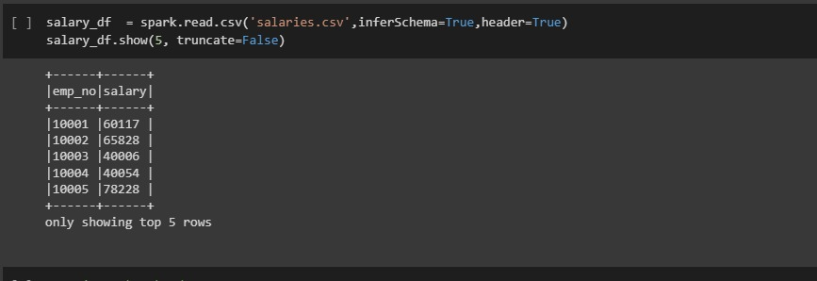
Code for department employee:
Code for salary table:

Slide 8
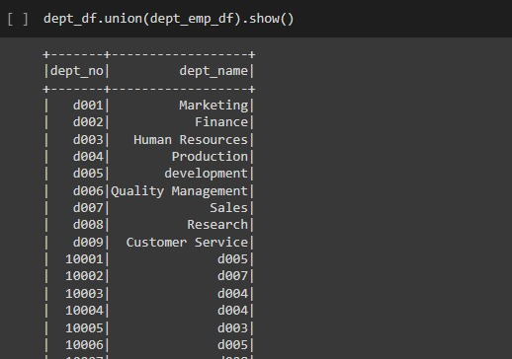
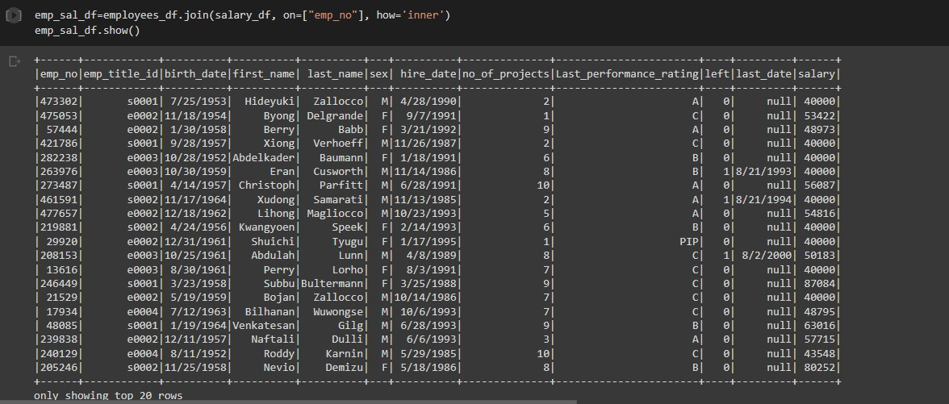
Performed union operation to join dept and dept_emp table
Performed an Inner Join operation to join employee and salary table

Slide 9
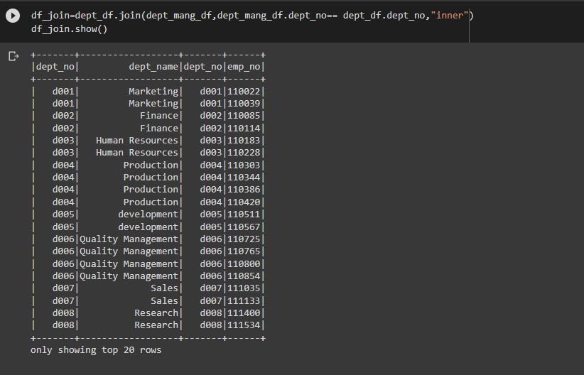
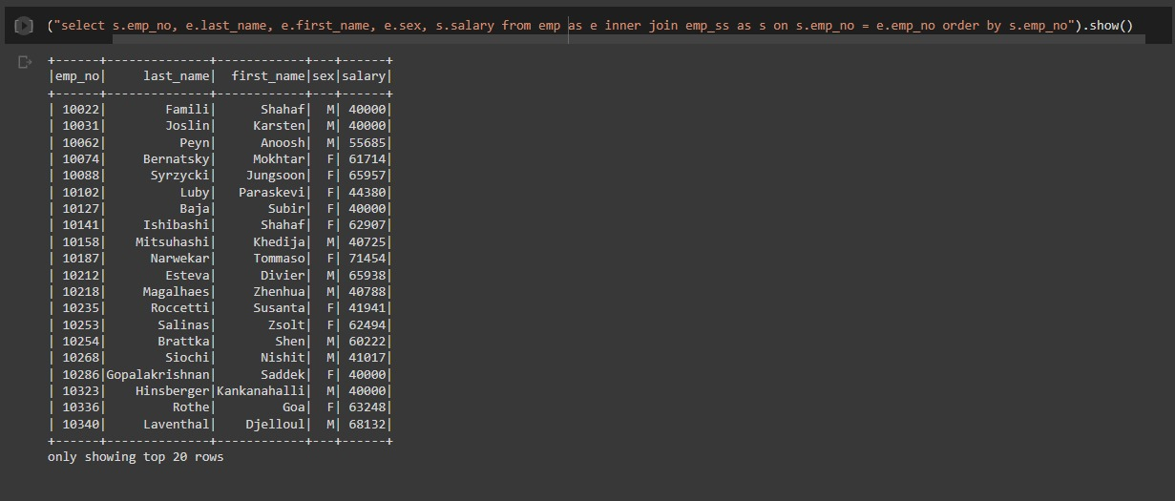
Performed an Inner Join operation to join dept and dept_mang table
A list showing employee number, last name, first name, sex, and salary for each employee1. A list showing first name, last name, and hire date for employees who were hired in 1986.

Slide 10
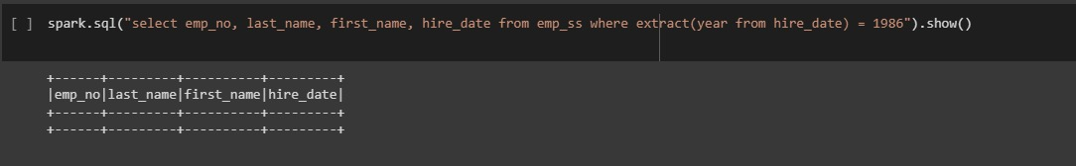
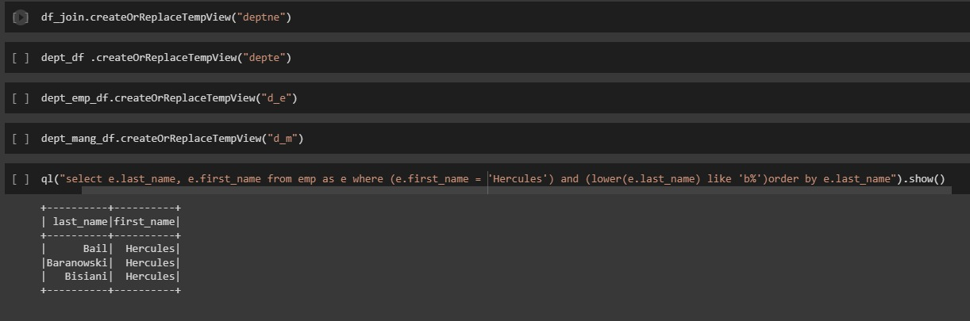
A list showing employee number, last name, first name, sex, and salary for each employee1
A list showing first name, last name, and sex for employees whose first name is "Hercules" and last names begin with "B.“

Slide 11
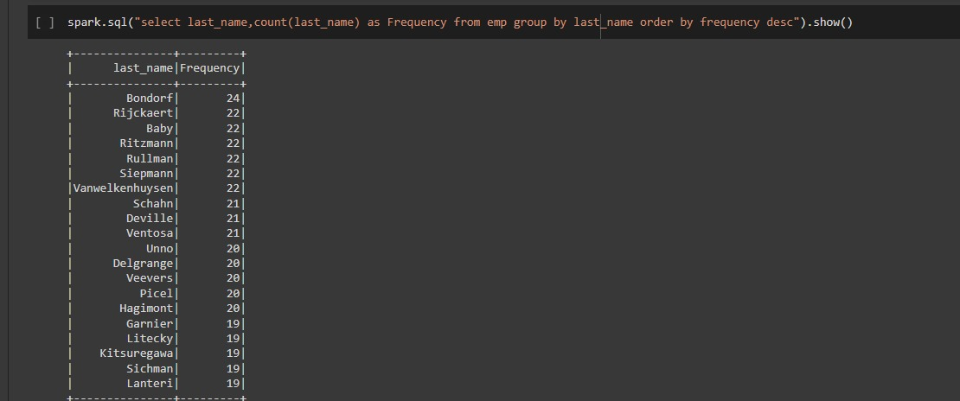
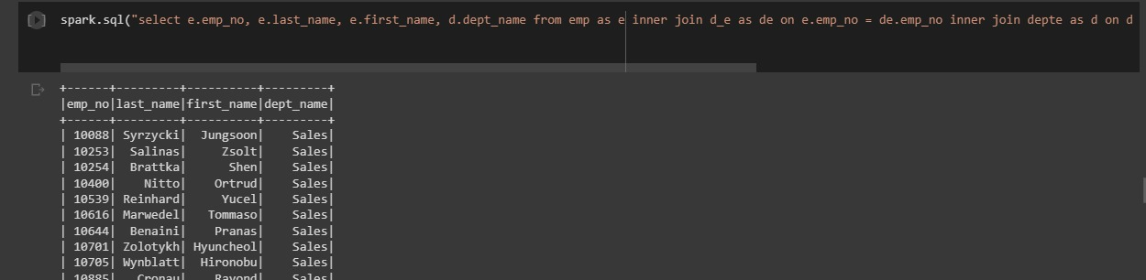
A list showing the frequency count of employee last names, in descending order. ( i.e., how many employees share each last name
A list showing all employees in the Sales department, including their employee number, last name, first name, and department name.

Slide 12
.A list showing the department of each employee with the following information: employee number, last name, first name, and department nam

Slide 13
CHALANGES FACED:
1.Choosing Data Formats, Schemas, and Development Frameworks
2.Unbounded Memory Requirements:While external memory algorithms for handling data sets larger than main memory, such algorithms are not well suited to data stream applications since they do not support continuous queries and are typically too slow for real-time response.
3.There is no subtract operation available in hive and thus we need to create two tables and perform left outer join on it with condition to accomplish the task.
4.Hive does not support update and delete operation on tables. Subqueries are not supported. The latency in the apache hive query is very high. Hive is not used for real-time data querying since it takes a while to produce a result

